Slide 1

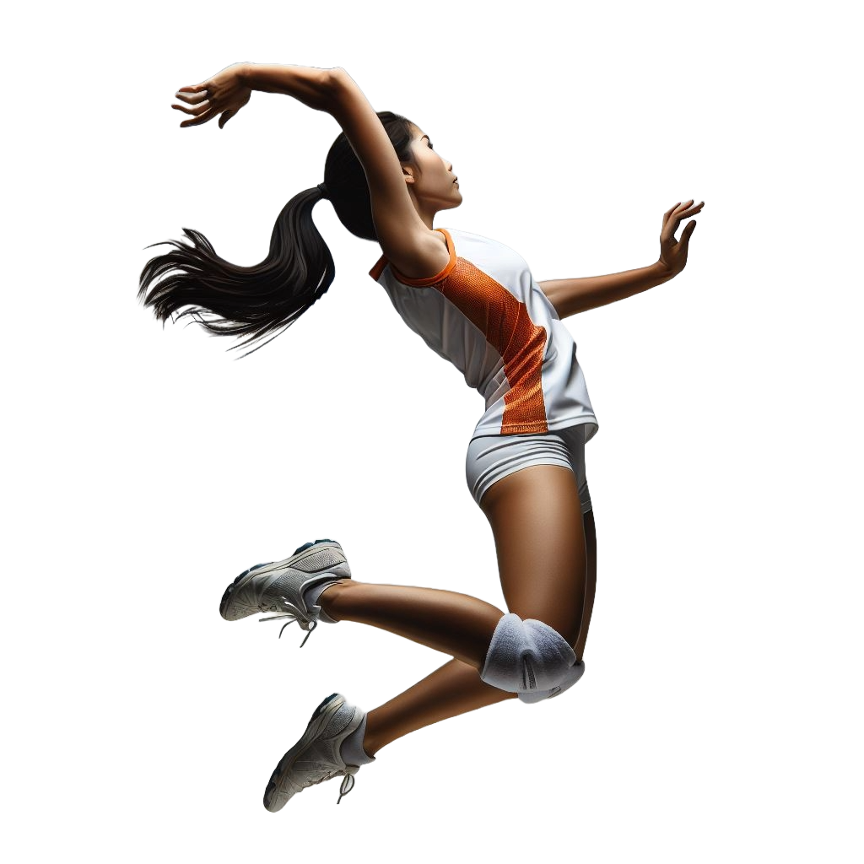
VOLLEYBALL INJURIES
Volleyball players can develop various types of injuries. Injuries occur most often in the lower extremity, specifically the knee and ankle. Read more about these injuries and how to minimize risk of getting them.
Hands, Fingers & Wrist
Range 8.74 - 15.58%
Head & Neck
Range 0.6 - 9.42%
Ankle sprains account for nearly 40% of volleyball injuries
Shoulder and arm
Range 1.3 - 14.29%
Trunk
Range 6.42 - 12.99%
Injury Prevention
Warm up
10-15 min warm-up program of jogging/ skipping, arm circles/crosses, leg swings, hip openers and shuttle runs
Conditioning
2-3X per week Regularly train for power and stability
Split squats, deadlifts, glut bridges, hip adductor/ abductor
Single-leg stands, hops
Plyometrics, landing softly with knees over toes
Agility ladder and change of direction drills
Core & Grunk Stability
Apply the FIFA+ program
Thigh, Hip & Leg
Range 4 – 9.37%
Knee
Range 10.3 – 25.5%
Foot
Range 4.5 - 5.62%
Ankle
Range 5.9 – 39.2%
Images and content created by Heather K. Vincent, PhD, FACSM © 2026
Scientific Sources: Baugh CM et al. Sports Health; Jan-Feb, 2018, 60-69; Miranda GE et al. Int J Sport Exerc Med. 1:1: 2015, 445.

Slide 2
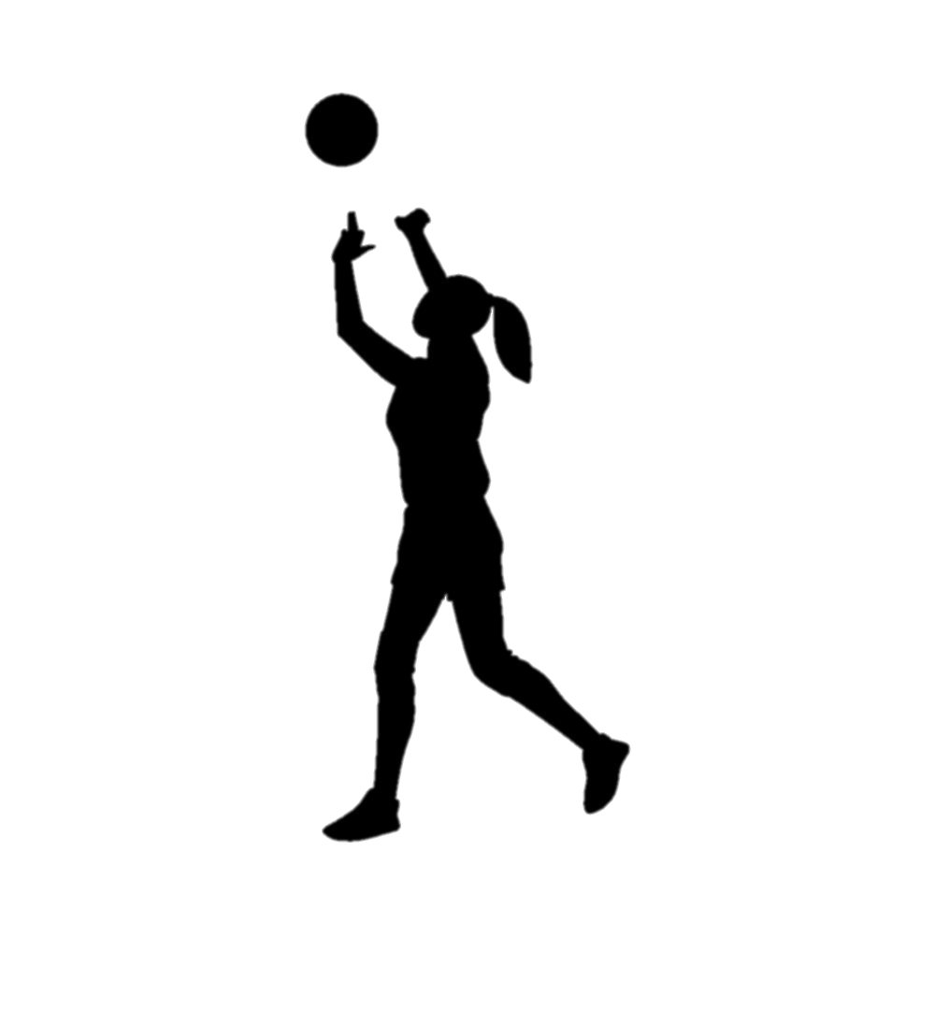

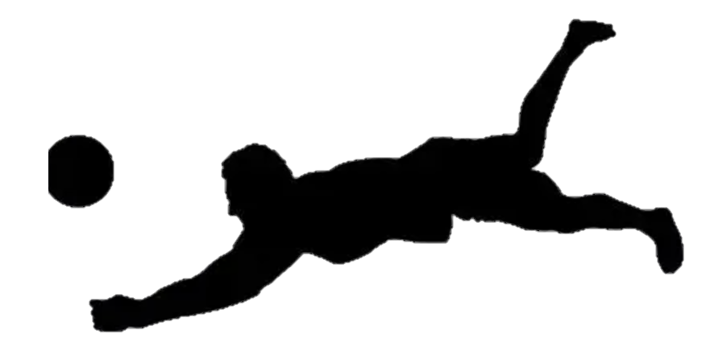
Specific Injury Prevalence by Sex and Experience Level values are in % of time loss and non-time loss injuries note: data on boys’ volleyball is highly limited
Injury Location | High School |  | Collegiate
 | Female | Male | Female | Male
Head/ face/ neck | 6.9 – 17.1 | 2 | 2.3 – 17.5 | 3.9 – 22.6
Neck | 0.4 – 0.8 | ---- | 0.5 – 1.6 | 0 - 0
Shoulder | 4.4 – 8.2 | 11 | 4.2 – 10.5 | 6.5 – 19.6
Arm/ elbow | 2.1 - 3.0 | 3 | 1.6 – 3.9 | 0 - 0
Hand/ wrist | 8.9 – 14.1 | 12 | 3.7 -10.8 | 12.9 – 17.6
Trunk | 5.8 - 7.8 | 12 | 8.5 – 11.8 | 12.9 – 11.8
Hip/ groin | 7 | 5 | 6.5 – 7.4 | 0 - 3.9
Upper Leg | 2.5 – 5.6 | ---- | 3.7 – 5.6 | 0 – 5.9
Knee | 10.3 -13.0 | 20 | 15.9 – 16.3 | 0.3 – 25.5
Lower Leg | 2.0 -4.3 | --- | 3.2 – 10.8 | 0.3 – 5.9
Ankle | 34.9 – 39.2 | 33 | 0.8 – 5.9 | 8.2 – 24.3
Foot | 1.4 – 4.4 | --- | 0 - 0.2 | 4.2 – 10.1
Other | 0.9 – 1.9 | --- | 0 - 0 | 1.6 – 5.3
Did you know...
One third of all practice-related injuries were overuse injuries.
Girls are more likely to be injured during practice, whereas boys are more likely to be injured during games.
Early volleyball specialization has been associated with a higher risk of overuse injuries
Visit the TOI team to learn more about your injury risk and develop injury prevention plans for your sport
Scientific Sources: Baugh CM Sports Health; 2018, 60-69

