Slide 1
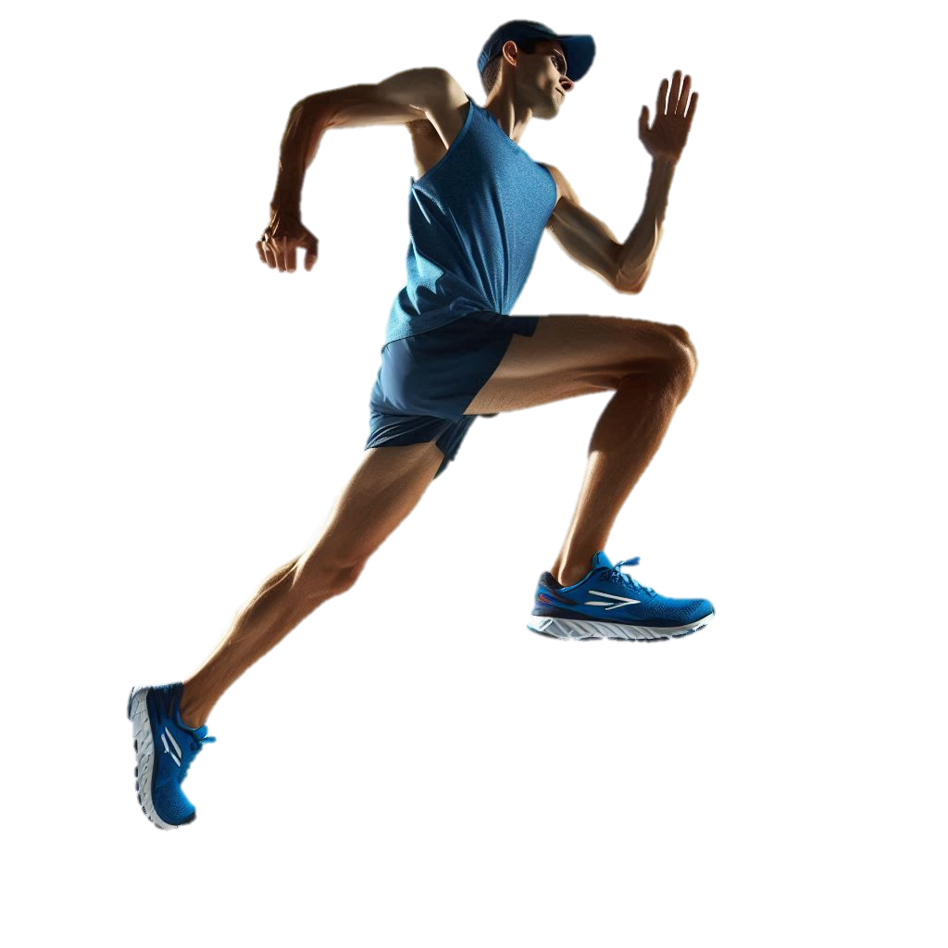
RUNNING INJURIES
Competitive and recreational runners commonly experience both overuse and acute injuries. Risks for injury include too rapid increases in training volume, lack of participation in other sports and strength training, poor shoes, poor neuromotor control, changes in terrain and speedwork and planning for a race. Pain should not worsen during an exercise bout or linger for more than 24 hours. Seek care.
Knee
31.2% (Range 11.6-48%)
Lower back
3.5% (Range 2.2-11.5%)
Hip and groin
7.0% (Range 4.0-14.5%)
Quadricep and hamstring
3.6% (Range 0.7-12.7%)
Lower Leg
20.1% (Range 7.8-35%)
Foot and Toes
14.4% (Range 5.2-34.9%)
Injury Prevention
Moderate changes in training volume. Progress slowly (no more than 5-10% increase n volume per week)
Regular and consistent free weight strength training and neuromotor exercise; single leg and challenging multijoint motion
Foot core training and shoes that promote healthy foot motion (low shoe drop, wide toe box, light weight, moderate cushion)
Ankle
13.3% (Range 11.6-48.0%)
Images and content created by Heather K. Vincent, PhD, FACSM © 2024
Scientific Sources: Kakourris N et al. J Sport Health Sci 2021;10:51322.

Slide 2
Specific Injury Prevalence
Injury | % | Comment
Patellofemoral pain (PFP) | 16.7 | “runner’s knee”, very common, aching., burning or sharp pains around kneecap
Medial tibial stress syndrome (MTSS) Stress fracture | 9.1 16.0 | Pre-fracture status, bone edema Bone fractures in foot bones, tibia, fibula
Patella tendinopathy | 12.7 | Pain under kneecap along tendon
Tibialis posterior tendinopathy | 16.0 | May be confused with posterior tibial stress fracture
Anterior knee pain | 15.8 | Pain on and around the front surface of kneecap
Metatarsalgia | 8.0 | Pain on bottom side of ball of foot, feels “like a pebble”
Plantar fasciitis | 7.9 | heel pain and stiffness, and inflammation along bottom of foot
Achilles tendinopathy | 6.6 | Pain, stiffness, swelling and weakness of tendons
Ankle sprain | 5.7 | Acute trauma to ankle with twist or inversion/ eversion
Meniscal injury | 5.0 | Tears in one of the C-shaped cartilage rings of knee; caused by twisting, rapid acceleration and deceleration
Low back pain | 4.7 | Chronic, generalized aching in low back
Sacroiliac injury | 4.0 | Deep seated pain, numbness, tingling, weakness, pelvic pain, and leg instability
Quadriceps/ hamstring tendinopathy | 3.6 | Pain/ tenderness above kneecap, worsens with activity; pain in tendons that attach hamstrings to knee, leg and pelvis
Gluteal strain or tendinopathy | 3.5 | Pain in buttocks, difficulty lying on affected side
Trochanteric bursitis | 1.1 | Inflammation of the bursa, a fluid-filled sac that cushions the hip joint
When musculoskeletal pain is not a normal pain:
Pain that increases during a running sessions, or if the pain quality changes (from achy to sharp
Pain that lingers for more than 24 hours after training
If mild pain is present (3/10 points on a 0-10 point scale), the pain should not worsen with exercise
or persist
Pain that causes limp or compensation in gait.
STOP! Seek a running medicine professional
Visit the TOI team to learn more about your gait pattern, injury risk and prevention plans
Scientific Sources: Kakourris N et al. J Sport Health Sci 2021;10:51322. Vincent HK &Vincent KR. Curr Sports Med Rep 2017; 16(3):122

