Slide 1
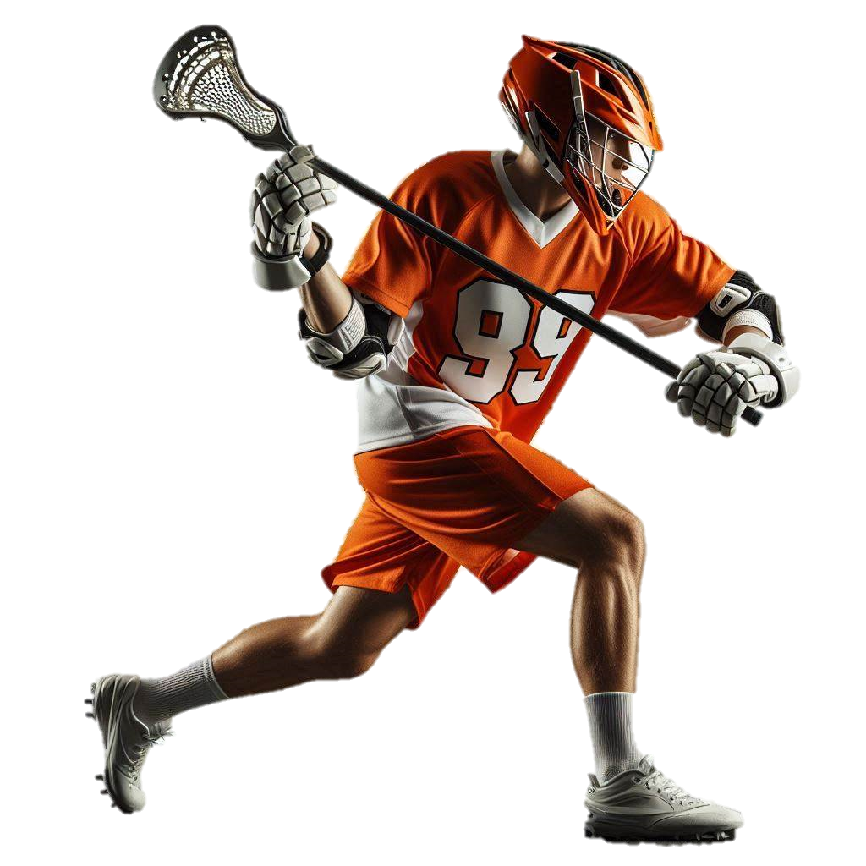
LACROSSE INJURIES
Lacrosse athletes are at risk for a variety of overuse and acute injuries. Injuries can occur from the head to the foot. Read more about these injuries and how to minimize risk of getting them.
Head and Face
Range 9.5-38.8%
Neck
Range 0.3-1.7%
Shoulder
Range 2.2-12.9%
Trunk
Range 1.1-10.2%
Hip/ groin
Range 6.4-17.9%
Hands, Fingers & Wrist
Range 2.9-9.3%
Knee
Range 10.6-18.2%
Leg
Range 3.6-14.1%
Foot
Range 1.4-7.6%
Ankle
Range 9.3-21.4%
Injury Prevention
Prepare 8-10 weeks in advance of the season with progressive running and conditioning; add ~10% volume or intensity per week
Weight training, complex multi-joint movements and neuromotor training programs can be used pre-season for injury prevention and during the season to maintain functional gains
Squats, deadlifts, single-leg squats, lateral bounding, jump and safe landing training, dynamic core movement, shoulder and chest press actions and grip strength
Rest at least one day a week, get ~7-8 hours of sleep, and eat enough calories for recovery!
Images and content created by Heather K. Vincent, PhD, FACSM © 2024
Scientific Sources: Vincent & Vincent. Curr Sports Med Rep.18(6)229-238, 2019.
Vincent & Vincent, Curr Sports Med Rep. 17(6):208-214, 2018.

Slide 2

Specific Injury Prevalence by Sex and Experience Level
Ranges are in practice and competition, respectively
Injury Location | High School |  | Collegiate
 | Female | Male | Female | Male
Head/ face | 17.9 - 38.8 | 16.8 – 31.9 | 15.2 | 9.5
Neck | 0.9 – 0.8 | 1.7 – 1.7 | 0.3 | 1.3
Shoulder | 0.6 – 2.0 | 7.6 – 12.9 | 2.2 | 8.7
Arm/ elbow | 0.9 – 1.7 | 2.8 – 3.0 | 1.5 | 3.3
Hand/ wrist | 2.9 – 8.2 | 8.1 – 8.6 | 3.2 | 9.3
Trunk | 3.8 – 1.1 | 6.1 – 7.3 | 6.4 | 10.2
Hip/ groin | 17.9 – 7.0 | 13.4 – 8.6 | 7.2 | 6.4
Upper leg | ---- | ---- | 12.1 | 13.7
Knee | 10.6 – 17.7 | 13.8 – 10.4 | 18.2 | 12.5
Leg | 14.1 – 3.9 | 9.9 – 3.6 | 10.8 | 6.7
Ankle | 21.4 – 16.9 | 12.0 – 9.3 | 16.0 | 13.7
Foot | 7.6 – 1.4 | 5.5 – 2.0 | 5.6 | 4.0
Other | 1.5 – 0.6 | 2.4 – 0.7 | 1.5 | 0.8
When most injuries occur
Most injuries occur during preseason or in the first weeks of the season as players are returning to sport ‘shape’.
Most common injury types
In females:
More non-contact related injuries
Sprain/strain (22%)
Concussion (11.5%)
Contusion (11.4%)
In males:
More contact-related injuries
Sprain/strain (25.9%)
Concussion (7.2%)
Contusion (16.7%)
Compared to practice, competition ↑ injury risk by 2.4 to 5.6 times in females and males.
Visit the TOI team to learn more about injury risk and injury prevention for your sport
Images and content created by Heather K. Vincent, PhD, FACSM © 2024. Scientific Sources: Garcia & Redler. J Hops Spec Surg. 20(2):288-297, 2024; Pierpont et al. J Athl Train. 54(1):30-41, 2019 and 54(1):42-54.

