Slide 1
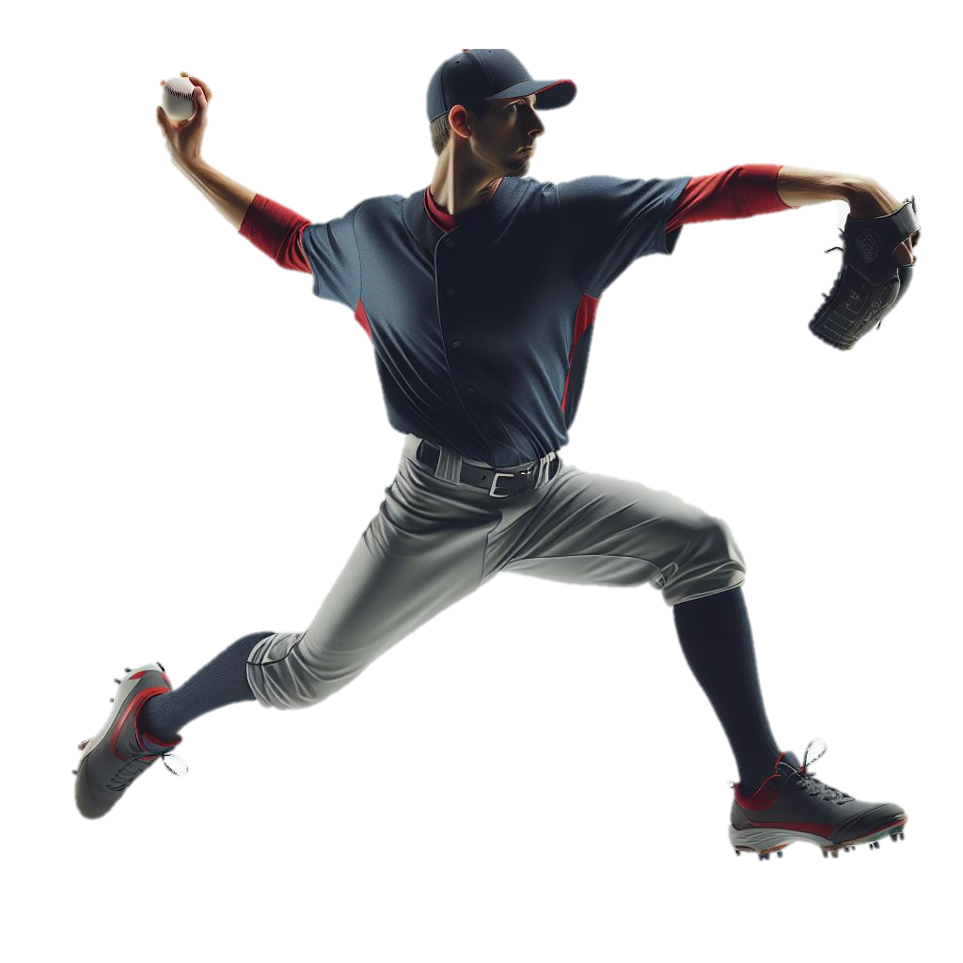
BASEBALL INJURIES
Baseball players who pitch or throw high volumes are at risk for a variety of overuse and acute injuries. Injuries can occur from the head to the foot. Read more about these injuries and how to minimize risk of getting them.
Shoulder
(11.8-21.1%)
Head & Neck
(6.8-19.6%)
Hand & Wrist
(11.8-21.1%)
Arm & Elbow
(11.9-15.5%)
Trunk
(4.0-9.7%)
Hip, Groin, Upper Leg
(8.8-15.3%)
Knee & Leg
(3.4-8.7%)
Ankle & Foot
(1.3-11.0%)
Maintain fitness all year round to prevent start of season issues, limit number of teams on which a player participates; practice other sports
Eccentric hamstring exercises (Nordic hamstring) can reduce injuries during play
Use safety equipment; follow volume recommendations for pitching; focus on technique
Yokohama Baseball-9 exercises help reduce medial elbow injuries in developing players
Follow a strength training routine for legs, core, upper body (squats, deadlifts, lunges, shoulder rotation/ scaption and sleeper stretch, planks, medicine ball throws)
Injury Prevention
Images and content created by Heather K. Vincent, PhD, FACSM © 2026
Scientific Sources: Wasserman EB J Athl Train. 2019, 54(2):198-211; Melguin HP Curr Rev Musculoskelet Med, 2018,11(1):26-34

Slide 2






Specific Injury Prevalence by Experience Level
Values are in practice and competition, respectively
Injury Location | High School |  | Collegiate
 | Practice | Competition | Practice | Competition
Head/ face | 17.6 | 18.7 | 6.1 | 10.5
Neck | 0.9 | 0.9 | 0.7 | 0.8
Shoulder | 18.5 | 11.8 | 21.1 | 16.2
Arm/ elbow | 12.2 | 11.9 | 15.5 | 14.7
Hand/ wrist | 12.4 | 15.4 | 10.0 | 14.4
Trunk | 5.8 | 4.0 | 9.7 | 6.3
Hip/ groin/ upper leg | 8.8 | 11.9 | 13.2 | 15.3
Knee | 7.3 | 8.7 | 7.0 | 6.5
Leg | 4.2 | 3.4 | 3.4 | 3.6
Ankle | 9.6 | 11.0 | 8.9 | 7.5
Foot | 2.0 | 1.3 | 2.7 | 3.4
Other | 0.6 | 0.9 | 1.8 | 0.8
The most common injuries by player position
Base Runner | Batter | Catcher | Infielder | Outfielder | Pitcher
Hip/groin thigh strains 15-34% Ankle sprain 12-15% | Hit by pitch Hand/ wrist fracture 10-11% Arm contusion 11% | Concussion 14-15% Hand/ wrist sprains 10-11% | Ankle sprain 9-11% Hand/ wrist fractures 10% | Hip/groin thigh strains 12-15% Concussion 10% Ankle sprain 9% | Arm/elbow sprain 14-17% Shoulder strain 8%
College injuries occur more during pitching (overuse); high school injuries occur more during fielding and with playing surface (field, bases).
Visit the TOI team to learn more about injury prevention plans for your sport

